Slide 1
PREDICTION OF CAR ACCIDENTS SEVERITY IN US
Applied Data science Coursera capstone Project
By. ANTO LOURDU XAVIER RAJ.

Slide 2
Index
Introduction
Data Understanding and Preparation
Data Analysis and Visualization
Deployment Model and Evaluation
Results
Future Research and Development
References

Slide 3
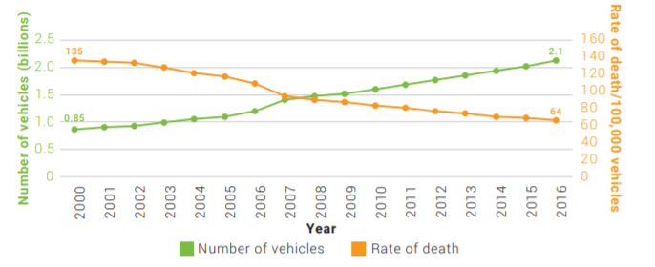
Introduction
World Health Organization’s Global status report on Road Safety 2018, number of road accident deaths are continued to climb, reaching 1.35 million in 2016.

Slide 4
Introduction continued…
Our first aim is to identify the key factors causing the accidents as mentioned in second and third phases (i.e., Data Understanding and Data Preparation) of Data science methodology.
Second step is developing a model that can accurately predict the severity of the accidents.
Identifying the patterns and Prediction will help the Traffic control Authorities, Transportation Department to impose and regulate the Traffic rules on Road safety.

Slide 5
Data understanding
US accidents Dataset with 3.5 million records and 49 columns collected from the Kaggle website.
Collected from February 2016 to June 2020.
Dataset Link: https://www.kaggle.com/sobhanmoosavi/us-accidents
Attributes
Traffic Attributes: Source, Severity, Latitudes, Longitudes, Start Time etc
Address Attributes: Street, Side, State, City, Time zone, county etc.
Weather Attributes: Wind_Direction, Weather, Temperature, Humidity etc..
Point-Of-Interest Attributes: Crossing, Traffic Signal, Bump, Junction, Stop etc
Period-of-Day (4): Sunrise/sunset, Civil_Twilight, Astronomical Twilight etc.

Slide 6
Data Preparation
Dropping Features: Less impact on severity and missing around 60% of data.(Turning Loop, Number, Description, End_Time)
Modifying and Adding Features: Start_Time, Weather_condition
Handling the missing values: Less count features were dropped.
Value Imputation: Filled by mean, median and mode.
Sampling the Data: Data is unbalanced with below values.
Total: 1032119 Severity 4 – 105167 Others – 926952
Sampling is done with value of 100000.

Slide 7
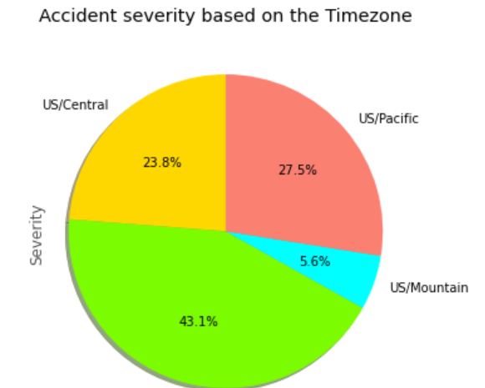
Data Analysis and Visualization
Analysis done by various Features
Time Features: Hour, Weekday, Year, Time Zone
Spatial Features: Latitude, Longitude
Weather Condition and Wind_Direction
State, Side of the Road
Period of Day Features

Slide 8
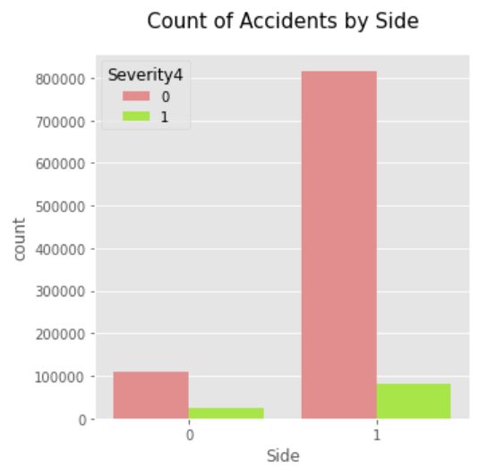
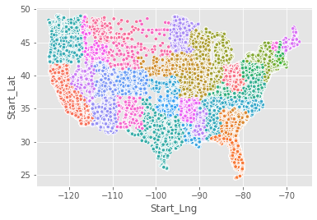
Data Analysis and Visualization
Right side is with high severity.
Accident Zone: North Eastern

Slide 9
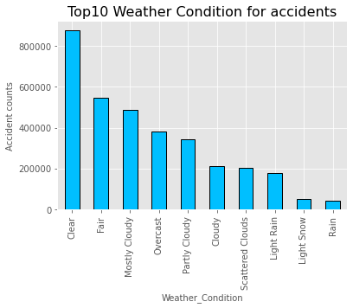
Data Analysis and Visualization
Clear and Fair weather conditions are highly serious when compared with cloudy, Rain, snow conditions.

Slide 10
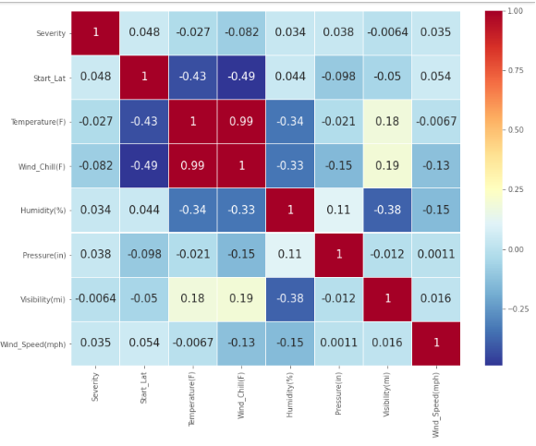
Weather Features correlation

Slide 11
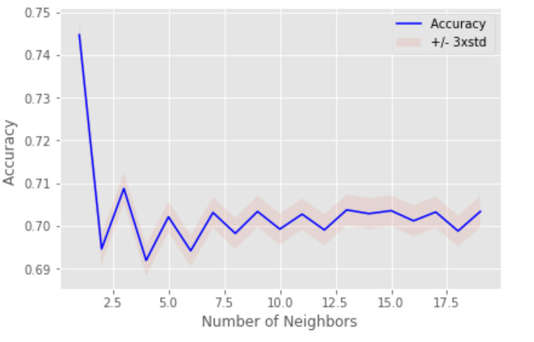
Deployment Model and Evaluation
KNN Classification
K-Nearest Neighbors,
Decision Tree
Support Vector Machine
Logistic Regression
Random Forest Classifier

Slide 12
Results
Classifier | Train Set Accuracy in % | Rest Set Accuracy in %
KNN | 85.15% | 70.87%
Decision Tree | 78.43% | 72.71%
SVM | 71.52% | 70.4%
Logistic Regression | 67.0% | 66.9%
Random Forest | 100% | 82.01%

Slide 13
RESULTS
The best evaluation is performed using Random Forest with high accuracy. The best models for prediction the accidents are.
Random Forest Classifier
KNN
Decision Tree

Slide 14
Further Research and Development
Inclusion of as many features as possible by making the newly created instance from already existing one feature for better prediction.
Weighted XGBoost, Naïve Bayes and other similar models can be implemented instead of resampling the dataset.
Detailed study of each feature and their correlation with dependent variable Severity will be done.

Slide 15
References
https://smoosavi.org/datasets/us_accidents
https://medium.com/@vaibhavgope02/predicting-accident-severity-with-us-accidents-dataset-4aeaaae0b0af
https://www.kaggle.com/vtech6/basic-analysis-us-accidents
https://www.kaggle.com/deepakdeepu8978/how-severity-the-accidents-is

